Slide 1
Behavioral and Social Science in Biomedical HIV Research
Dianne Rausch, Ph.D.
Director, Division of AIDS Research
National Institute of Mental Heanth

Slide 2
Behavioral and Social Science Spanning Discovery to Implementation Science
Behavioral & Social Science
Discovery Science
Translational Science
Implementation Science

Slide 3
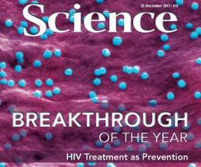
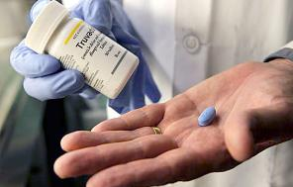
Advances in HIV/AIDS
PMTCT
Combination ART
Benefit of early ART
Treatment as Prevention (TasP)
Rapid (self/home) HIV testing
Pre-exposure prophylaxis (PrEP)

Slide 4
Behavioral and Social Science
In an era of great biomedical advances in HIV/AIDS, what contributions can behavioral and social science make?
Improving use and impact of proven products/strategies
Strengthening biomedical HIV research

Slide 5
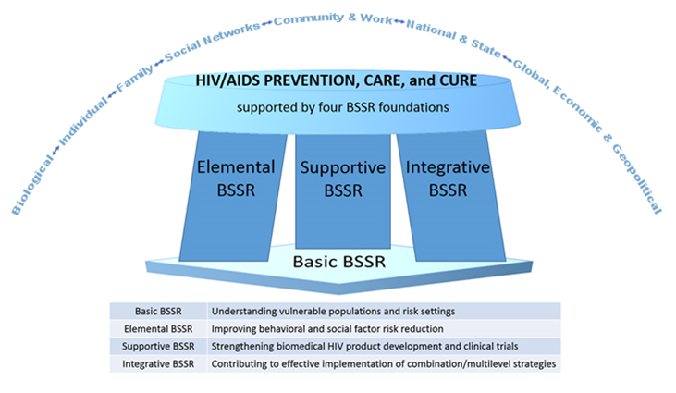
A Framework for Behavioral and Social Science (BSSR) in the Fight Against HIV/AIDS
Gaist & Stirratt JAIDS 2017

Slide 6
Optimizing Real-World Impact
Drug
Behavioral support
Effective care and service provision
Provider and clinic factors; culturally competent care
Supporting care engagement, retention, and adherence
Supportive social, structural, and policy environments
Addressing stigma; community support; structural barriers
Oral ART, PrEP, PMTCT, long acting regimens, prime-boost vaccines, etc.

Slide 7
Behavioral and Social Science Research Along the Continuum
Uptake of PrEP
Behavior Modification
Routine HIV Testing
HIV Prevention
Psychological Processes
Mental Health Depression
Anxiety
Comorbidities
Stigma
Resiliency
Social Support
HIV Testing
Key Populations- across the lifespan
Linkage to HIV Care
Adherence
Treatment as Prevention (TasP)
Policy
Financial Assistance
Food Security
Violence
Social Networks

